Slide 1
Algorithm Trading Utilizing Machine Learning
Project 2 - Team 5

Slide 2
Meet The Team
Felipe Jdanov
Hazel Akongoh
Oby Nwafor
Kala Pi

Slide 3
Intro
This is an experiment to see if Machine Learning might be helpful to algorithm trading.
Our first model is a simple up/down signal algorithm using neural network training.
The second model is Simple Moving Average algorithm trial on a new ML method: Calibrated Classifier
We try to probe an end-to-end practical process yielding actual trading actions, into which those premiumly trained ML models can be plug and play.

Slide 4
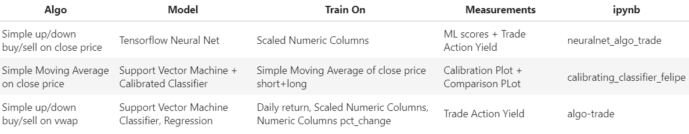
Summary

Slide 5
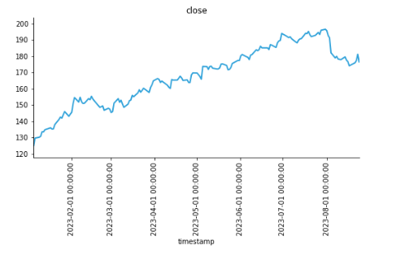
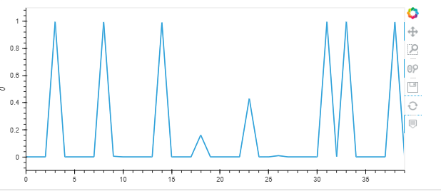
Model 1: Predictive Analysis Using Neural Network
Why Neural Network
The algorithm can recognize hidden patterns and correlations in raw data and cluster, and over time continuously learn and improve.
It provides options and parameters that are adjustable, these parameters can be changed continuously throughout the learning process to improve the overall output result of the model.
Key Highlights
Data was sourced from Alpaca: 6 Months Trading data
Defined a Simple Momentum strategy utilizing the percentage change
Created the features and target dataset & split the dataset for testing and training
Scaled the features data, assigned number of input features, layers and neurons per layer
Evaluate model to determine loss and accuracy

Slide 6
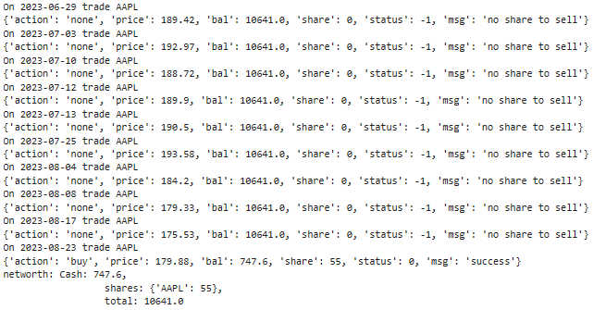
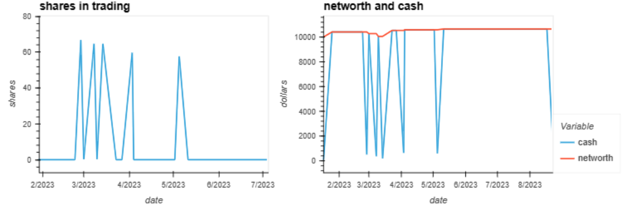
Model 1: Predictive Analysis Using Neural Network - Result
Results and Deductions
While the overall accuracy score of the model was low, this did not impact the performance of the trade
Key Metrics:
Start with 10k, perform one trade action per day for 15 days
Networth at the end of 15 days: 10,641.0

Slide 7
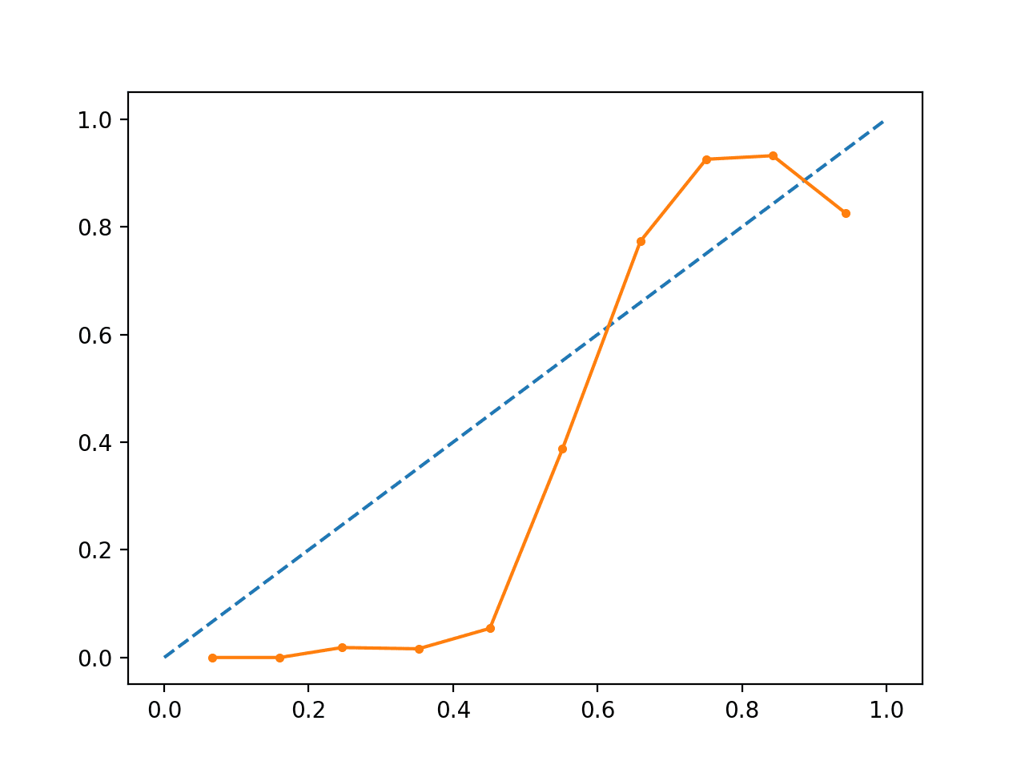
Model 2: Probability Calibration
Most models are not calibrated and they predict values are close to 0 and 1 in many cases where they should not be doing so.
Calibrating a classifier has the objective to improve the predictions of the model giving a more reliable prediction. On the other hand, when the model is able to find a good calibration by itself, the classifier is not able to improve the result.
The Classifier model is able to use two methods to improve the prediction, "sigmoid" and "isotonic”. For this example, we used the sigmoid method over the SVM.
The representation of the model is a graphic that goes from 0 to 1 with a diagonal line crossing it, that line represents the perfect prediction. And has a solid line connecting the predicted points. The closer the point is to the diagonal line, the better the prediction.

Slide 8
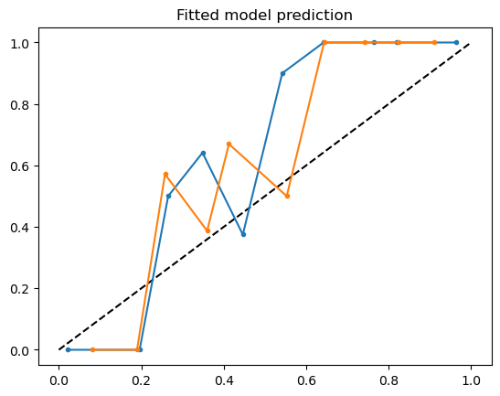
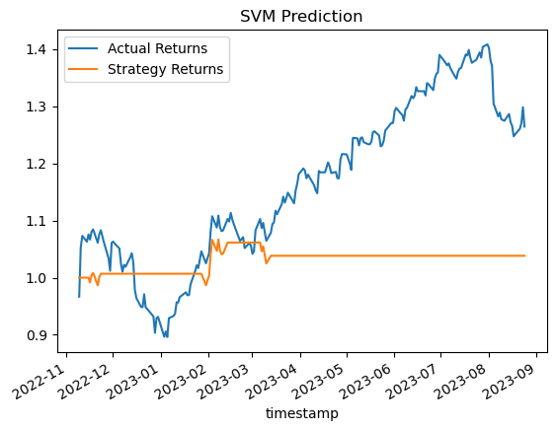
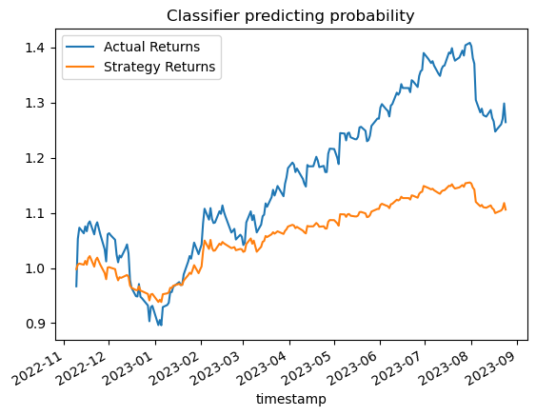
Model 2: Probability Calibration
Applying the class sklearn.calibration.CalibratedClassifierCV to Probability Calibration
In this project we use one year of AAPL stocks, Move Average for Technical Analysis and the Support Vector Machine to first fit the model and then use the Calibrate Classifier to improve the prediction probability.
The blue line is the non-calibrated SVM, and the orange line is the Calibrated Classifier model.
SVM uses the function predict(),
which returns a single discrete category
that it has predicted.
The Classifier uses the function
predict_proba(), which returns continuous
values that represent the likelihood of
each input belonging to each class.

Slide 9
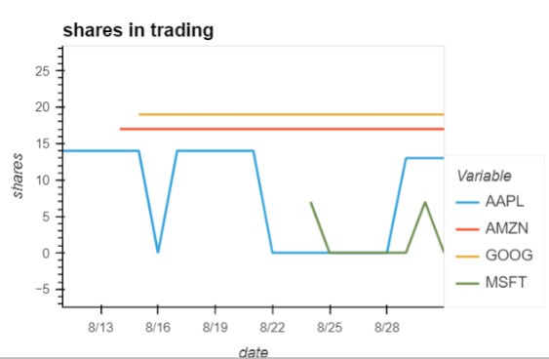
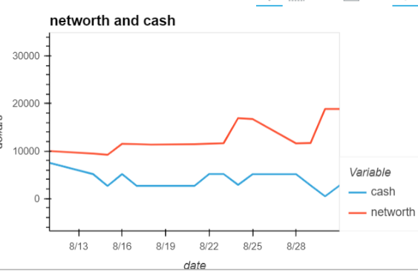
Algo Trade Lab
An experiment to see if Machine Learning might be helpful to algorithm trading.
Challenges in algo trade:
We could only decide tentative labels which are far from actual answer, meaning even if the ML model gets high score, it still does not guarantee a good outcome. We'd need to go with some different kind of measurement.
We are actually trying to predict the future, when no data is yet available. Instead of splitting train and test sets, we should only train then predict once at a time, like in the reality tomorrow comes one at a time.
Use the ML model predictions as the trade actions for 15 days.

Slide 10
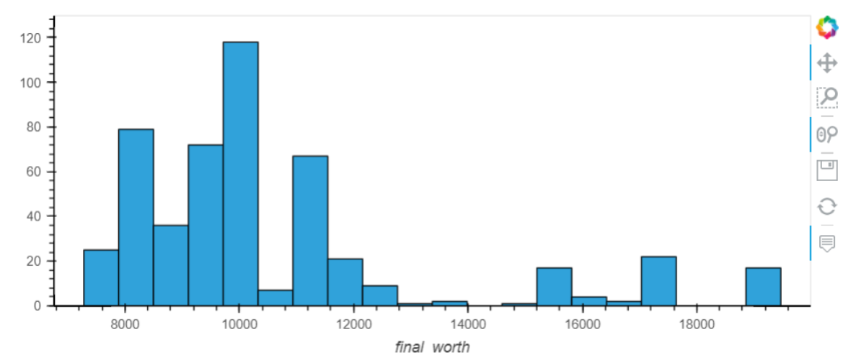
Trade Actions
Experiment design is pretty much random, only to facilitate prediction->action->result flow.
A primary ticker and some supplemental tickers from Alpaca historical data up to now
Train for some days then predict buy/sell one day at a time.
Action on the predictions starting cash of 10K, see in the end how much it becomes.
Run the process for 500 times to measure the prediction distributions.

Slide 11
Conclusion
So far we cannot conclude that ML works for algorithm trade.
There are many next steps out there to keep the hope on:
. Find better ticker
. Try more ML libs and models
. Tweek the algorithm to include more variable.

Slide 12
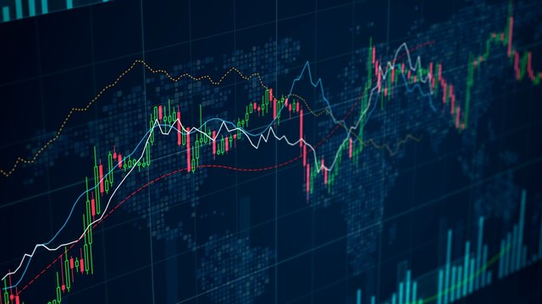
Thanks!

